Slide 1
Isometric Drawings &
Coded Plans
Module 3
HigherEdServices.org

Slide 2
Session Topics
Isometric Axes
Coded Plans
Objects from Multiple Viewpoints
Isometric Sketching

Slide 3
Isometric Sketching
Used to portray a 3-D object on a 2-D sheet of paper.
The relationship between the 3-D axes appears differently when projected onto a 2-D surface, i.e., perpendicular angles no longer appear perpendicular.

Slide 4
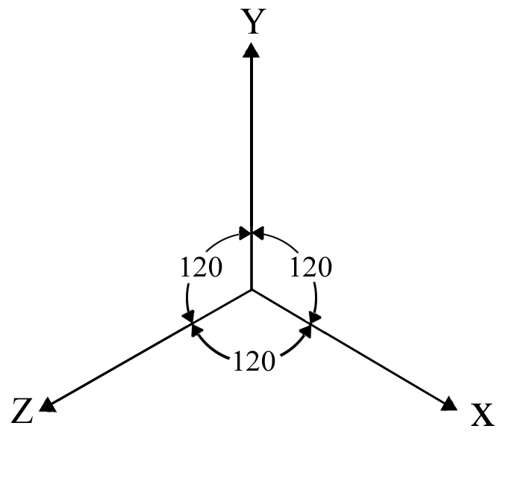
Isometric Axes
Notes:
3 axes, 120 degrees apart.
A sketch made using an isometric axes is called an isometric sketch.

Slide 5
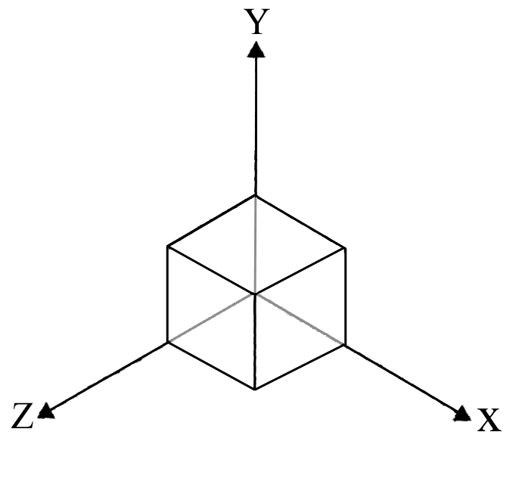
Isometric Sketch of Cube
Isometric sketches are made as if you were looking down a diagonal of a cube
The surfaces of the cube appear to be rhomboidal
Note that all surfaces of an object sketched in isometric will appear distorted!

Slide 6
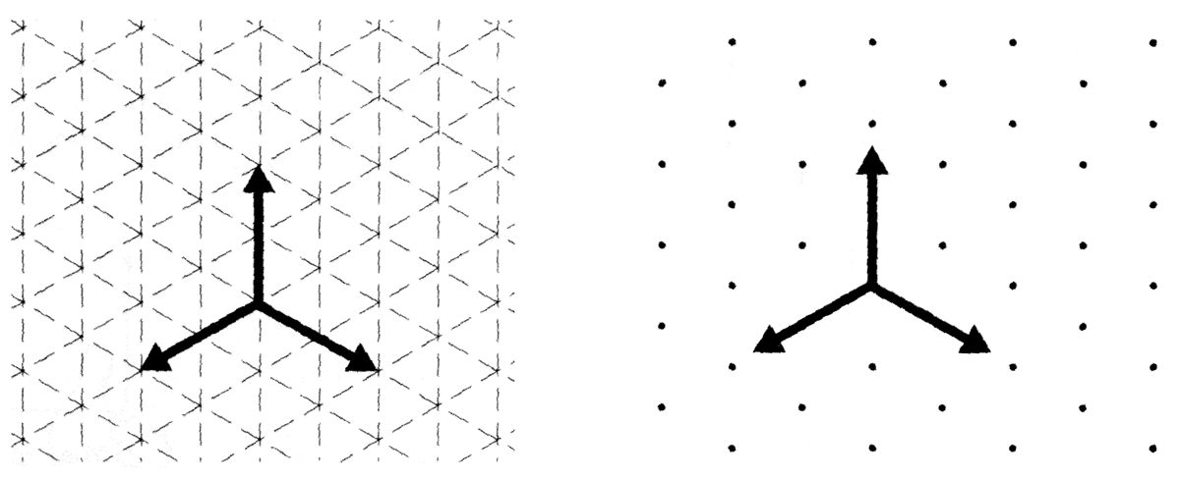
Isometric Axes
Isometric grid paper or dot paper is a useful tool for constructing isometric drawings.
Notes:
Explain the proper use of dot paper. Some students try to use it with the wrong way up.

Slide 7
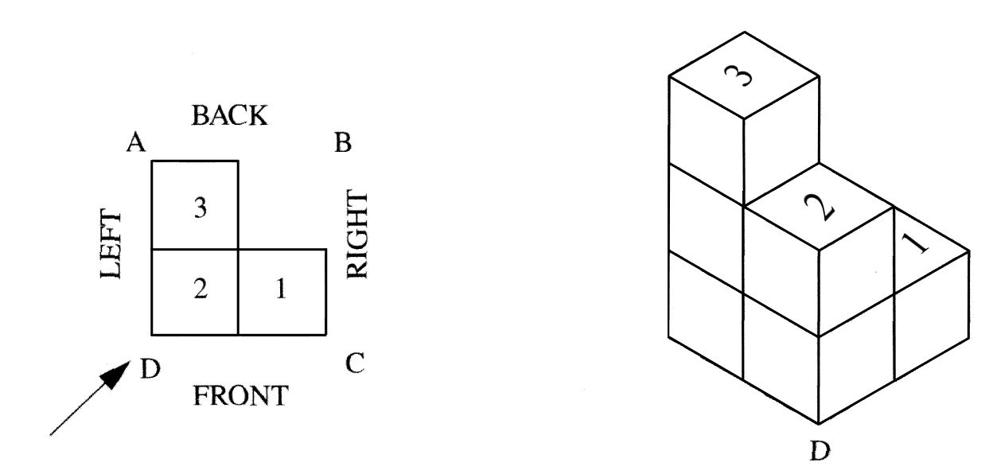
Coded Plans
Pictorial sketches can be made from coded plans.
Coded plans define the shape of a building made of blocks.
Coded Plan
Building
Notes:
The number on the code represent how tall the blocks are stacked.
The coded plan can be sketched on an isometric coordinate system or an oblique coordinate system.
If it is sketched on an isometric coordinate system, it can be sketched from any of the four principle corners.
If it is sketched on an oblique coordinate system, it can be sketched from any of four sides.

Slide 8
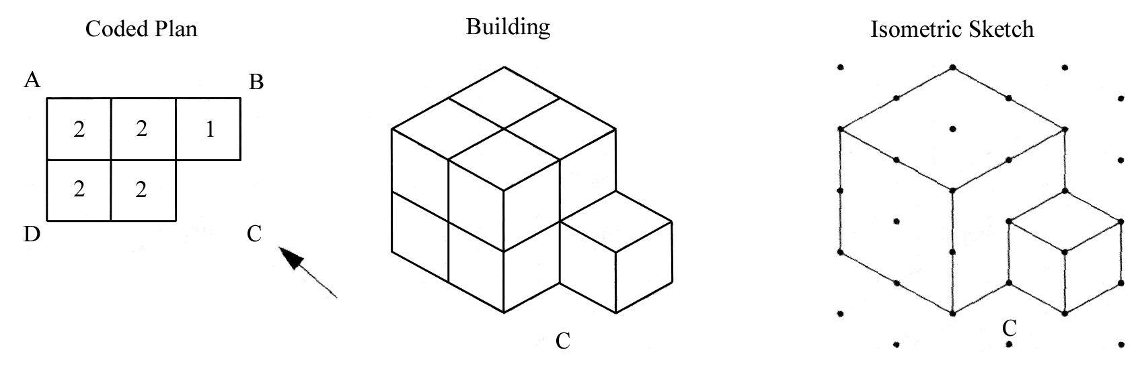
Coded Plans
Isometric sketch from corner C.
Notes:
Students must understand that when they are asked to draw the object from a corner, they must draw the view looking towards that corner from a position away from the object.
Individual cubes are not shown. Only edges where two surfaces intersect are shown with lines.

Slide 9
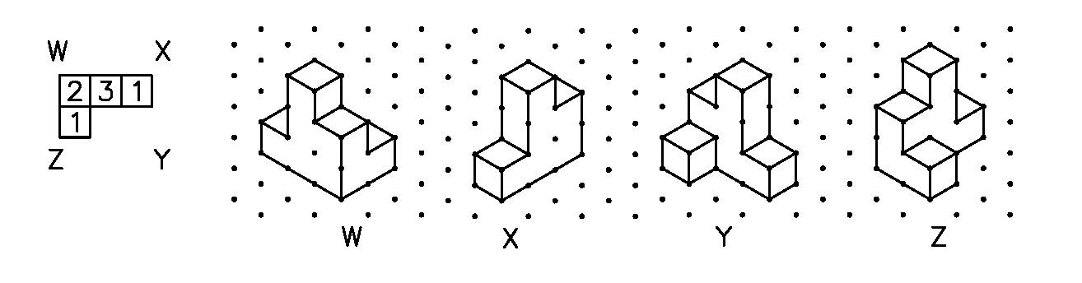
Different Viewpoints
The object will appear differently depending on the corner you are viewing it from

Slide 10
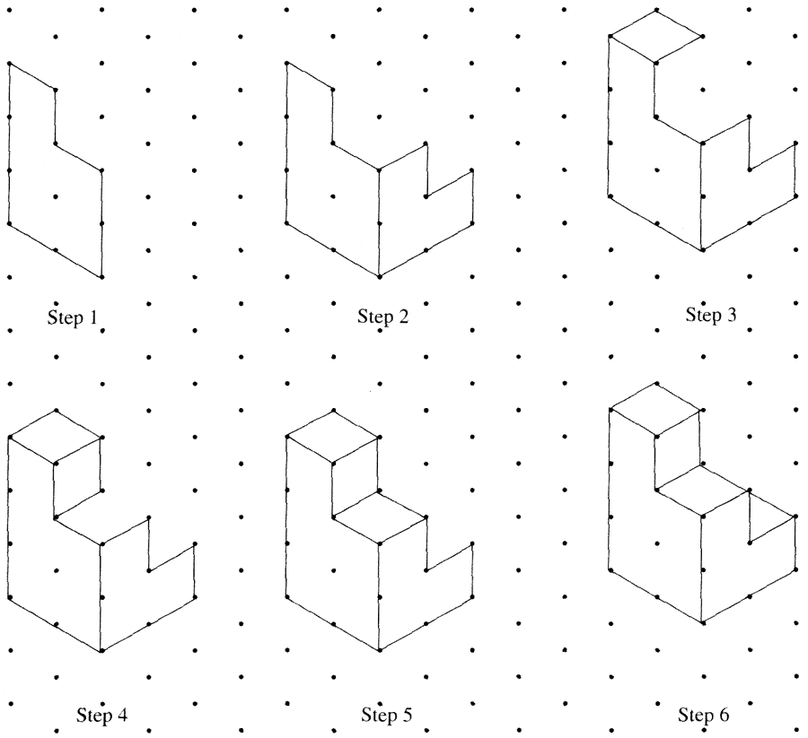
Isometric Sketching
3
1
2
1
C
Guidelines for constructing isometric drawings:
Draw edge "C".
Sketch surface to the right or left of edge “C”.
Draw a surface that shares an edge with the surface just drawn.
Continue drawing one surface at a time until the object is complete.
NOTE: Do not show the individual blocks in the building. Just show edges where surfaces intersect.
C
Steps 1 & 2
Step 3
Step 4 ...
Step 4 ...
Notes:
Do not outline each cube when drawing iso sketches. Rather, place lines where surfaces intersect to form edges.
Some students may find it helpful to draw each cube. Be sure they erase the extra lines when finished.

Slide 11
Course Software……
Work through the Isometric Drawings and Coded Plans software module

Slide 12
Homework
Complete the following pages in Module 3
iso-
  1 - 5
  8 - 11

